Slide 1
ToolWatch Mobile Request

Slide 2

ToolWatch Mobile
Saulsbury utilizes ToolWatch to manage inventory of company owned Tools and Equipment located at Warehouses and Job Sites. ToolWatch provides an app for mobile devices to submit request from our managed catalog of assets.

Slide 3
Current Tool and Equipment Requisition Process
The current requisition process for Saulsbury owned tools and equipment involves filling out one of various versions of either an Excel or PDF form, and emailing them to assetmgtreq@saulsbury.com
Disadvantages
Updates/changes to the standard form must be re-distributed to all employees
No access to the managed Model Record catalog descriptions and images
Miscommunication of correct items and assignment details
Progress tracking of fulfillment process not available

Slide 4
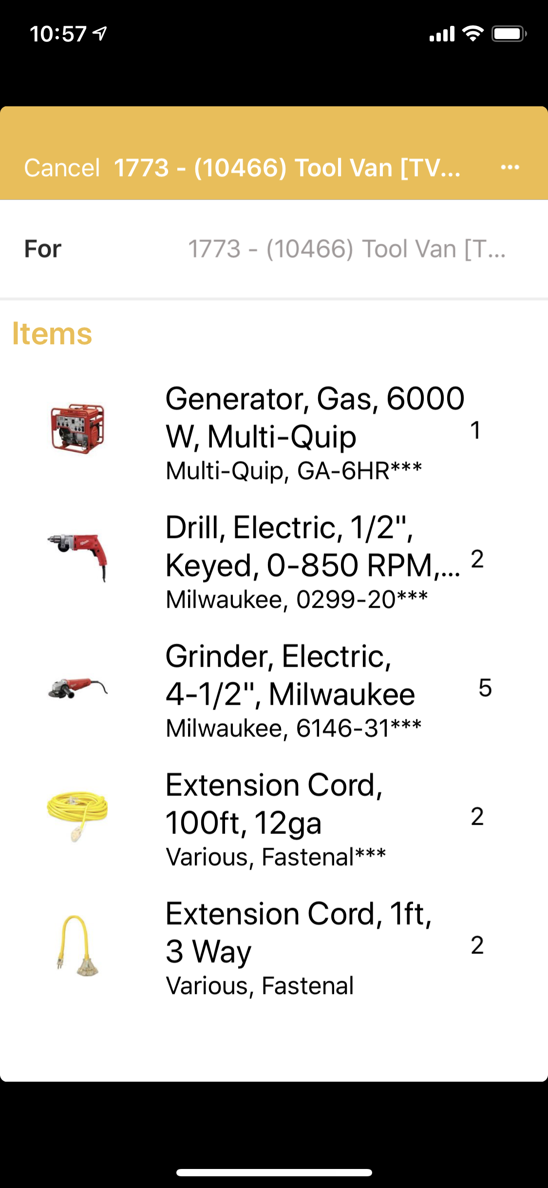
ToolWatch Mobile Request
To streamline the requisition process, we will transition from emailing the submission forms, to empowering the job site, through creating their own request using the same systems as the warehouse employees.

Slide 5
Submitting a Request using ToolWatch Mobile

Slide 6
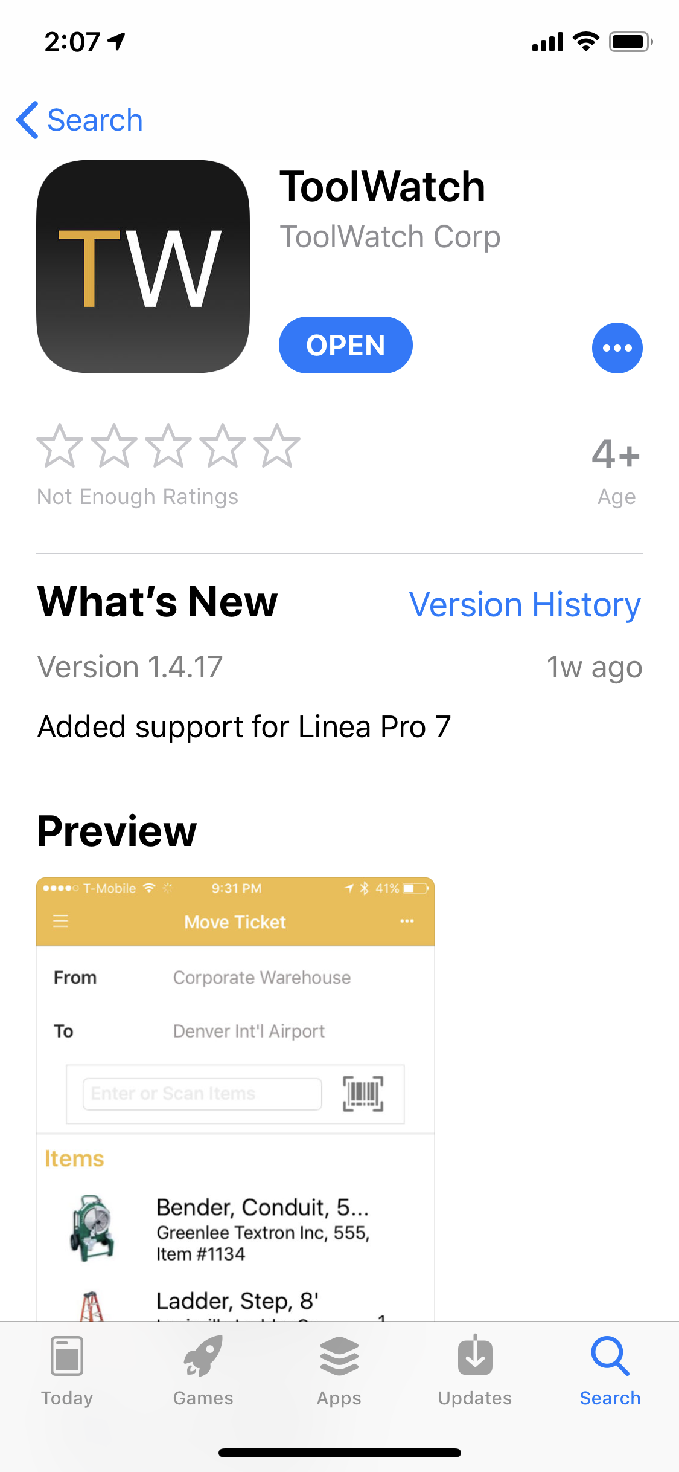
Installing ToolWatch
On your iOS device, go to the App Store, search for ToolWatch, and install on your device. The App has a black icon with the letters “TW”.

Slide 7
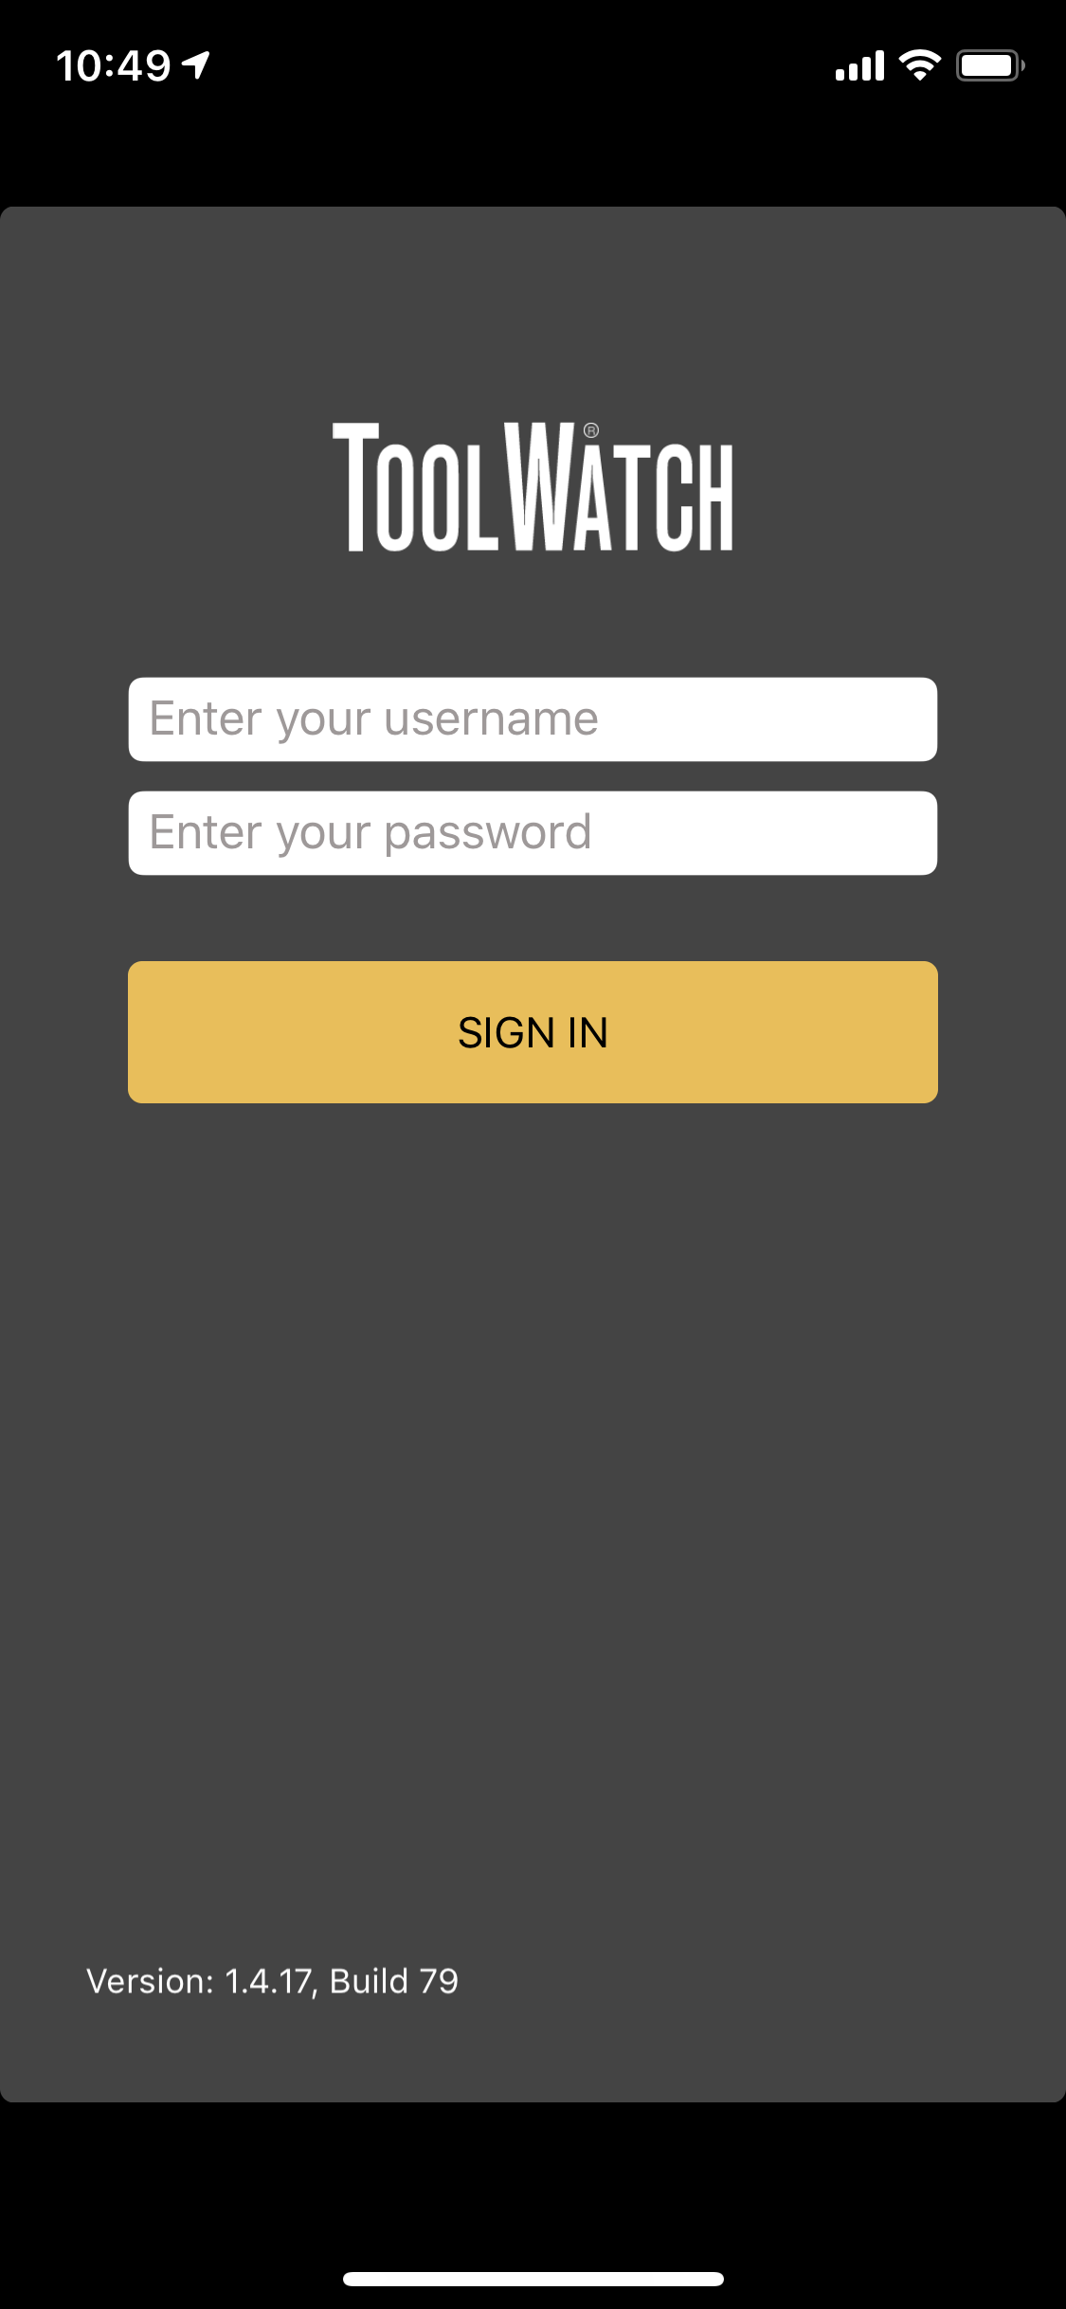
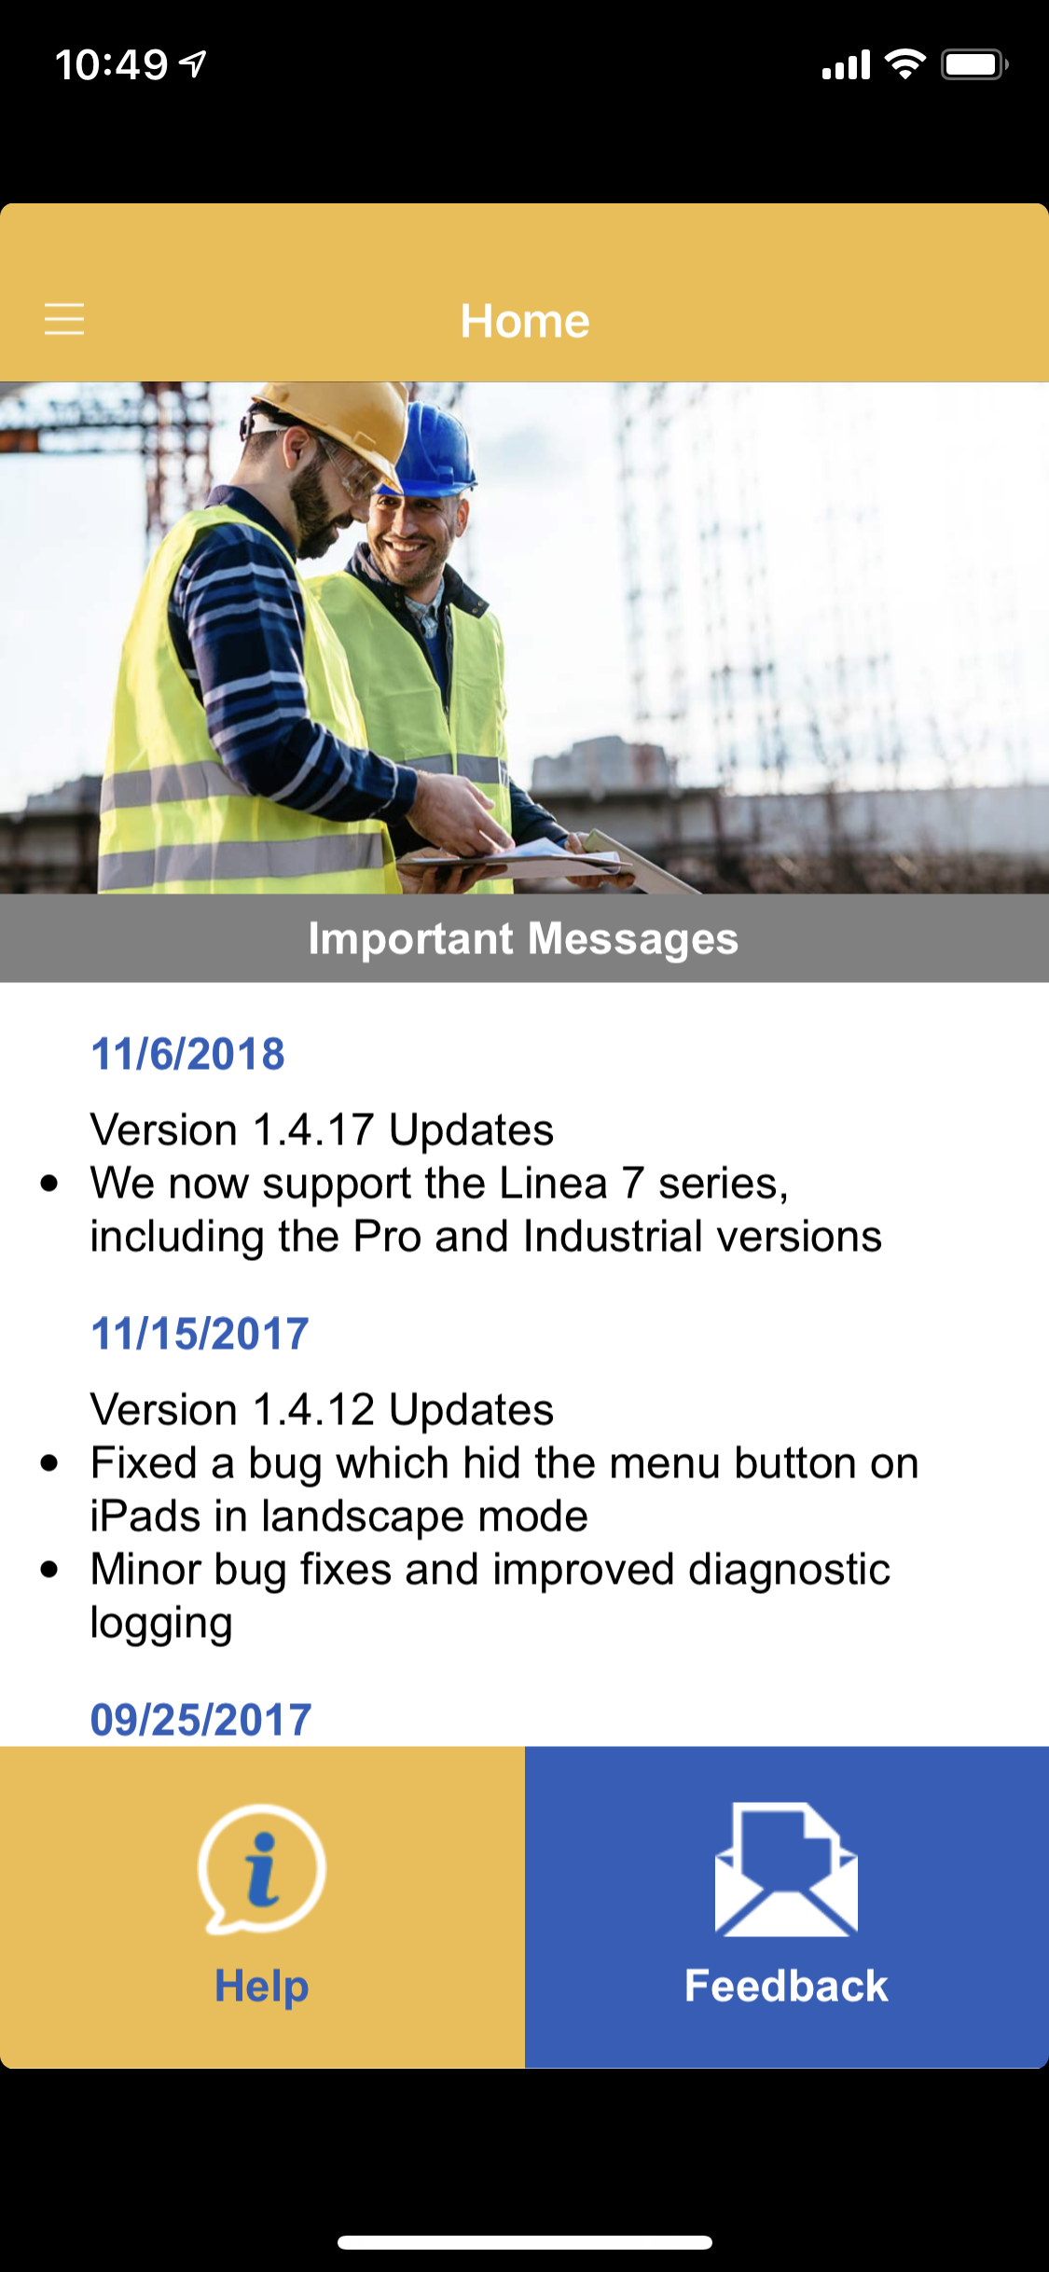
Signing in to the App
Enter your Saulsbury email address in the username field along with the password provided to you and tap Sign In
The Home screen of the app will appear after signing in and display any recent updates or changes from ToolWatch.
The top left icon represented by 3 lines is the menu button.
Tap the menu to see the options.

Slide 8
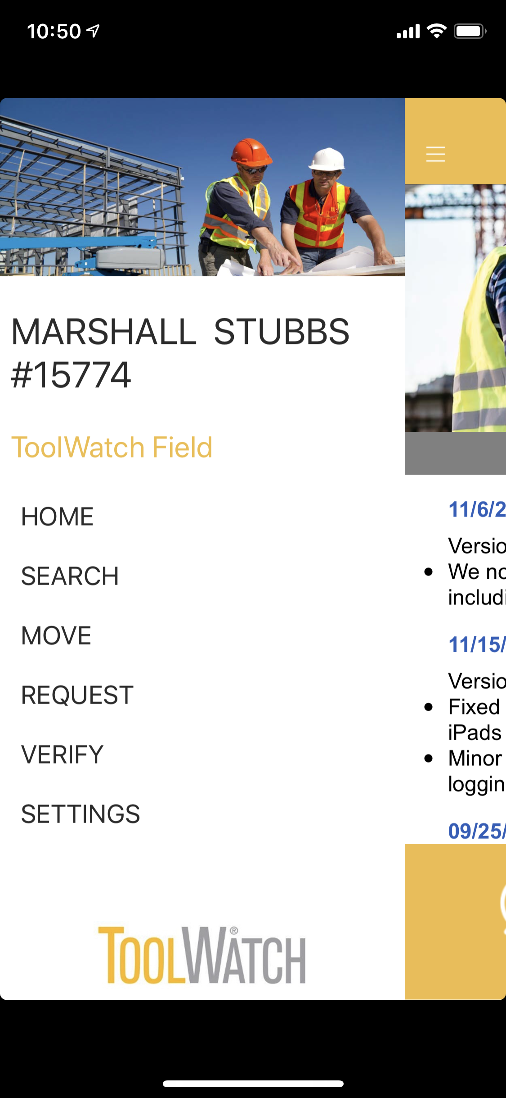
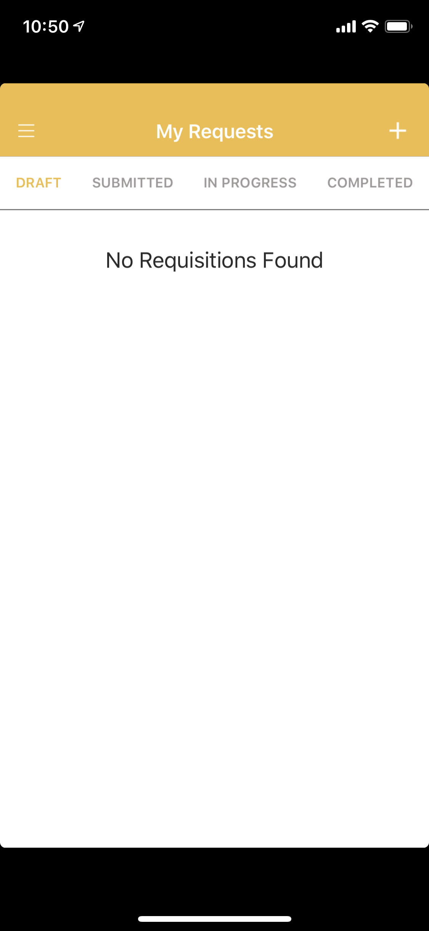
Creating a Request
The name and employee number of the user logged in will be displayed at the top.
To submit a Request, tap “Request” on the Menu.
Under “My Requests” you will have 4 views:
Draft
Submitted
In Progress
Completed
As the status of your Request changes, each Request will be listed under the appropriate view.
Tap the plus + to create a new Request

Slide 9
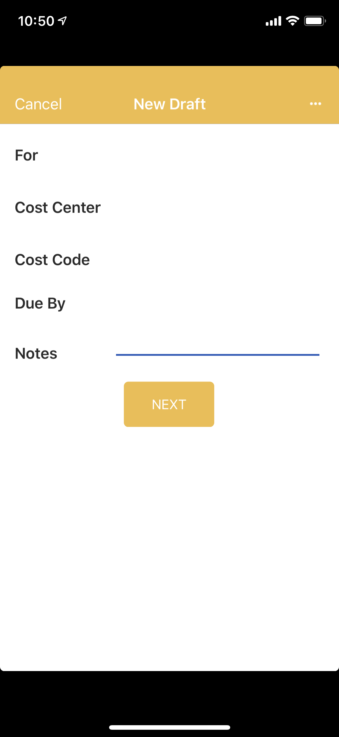
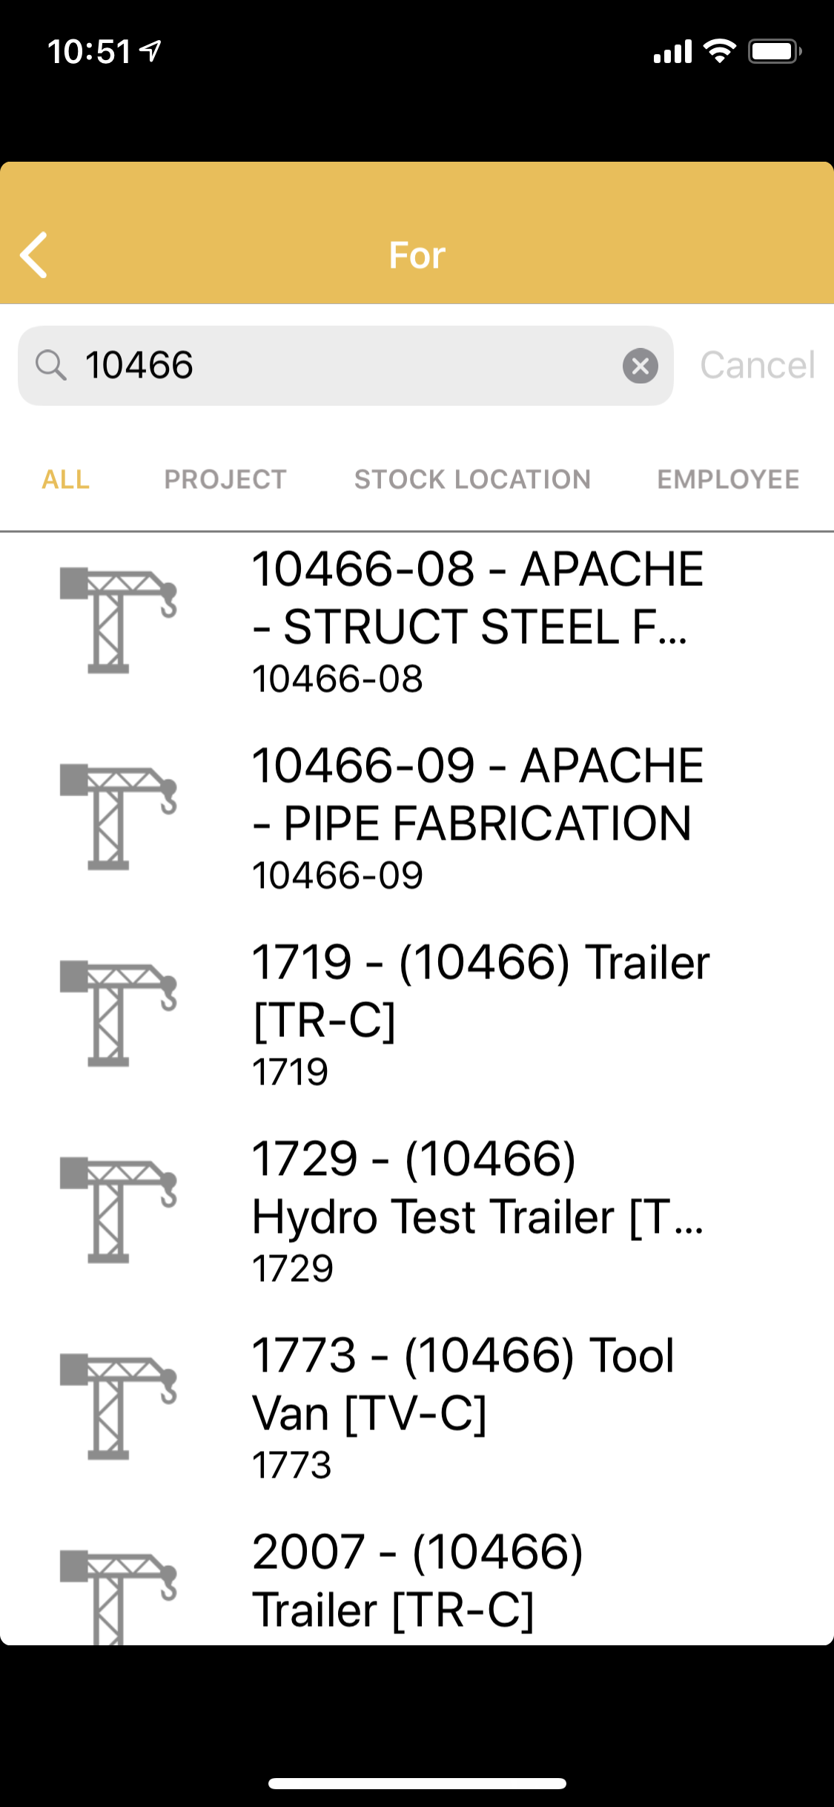
Drafting a Request
All new Requests are created in a “Draft” status. A draft can have tools added, saved, and added to again later before submitting, to prevent submitting multiple single item Requests.
Tap the blank area next to “For”, to specify where the items should be assigned/stored.
This will open a search box, type any part of the job number or tool van unit number, and the list will automatically filter to all locations with partial matches.
Tap the location the requested items should be assigned to.

Slide 10
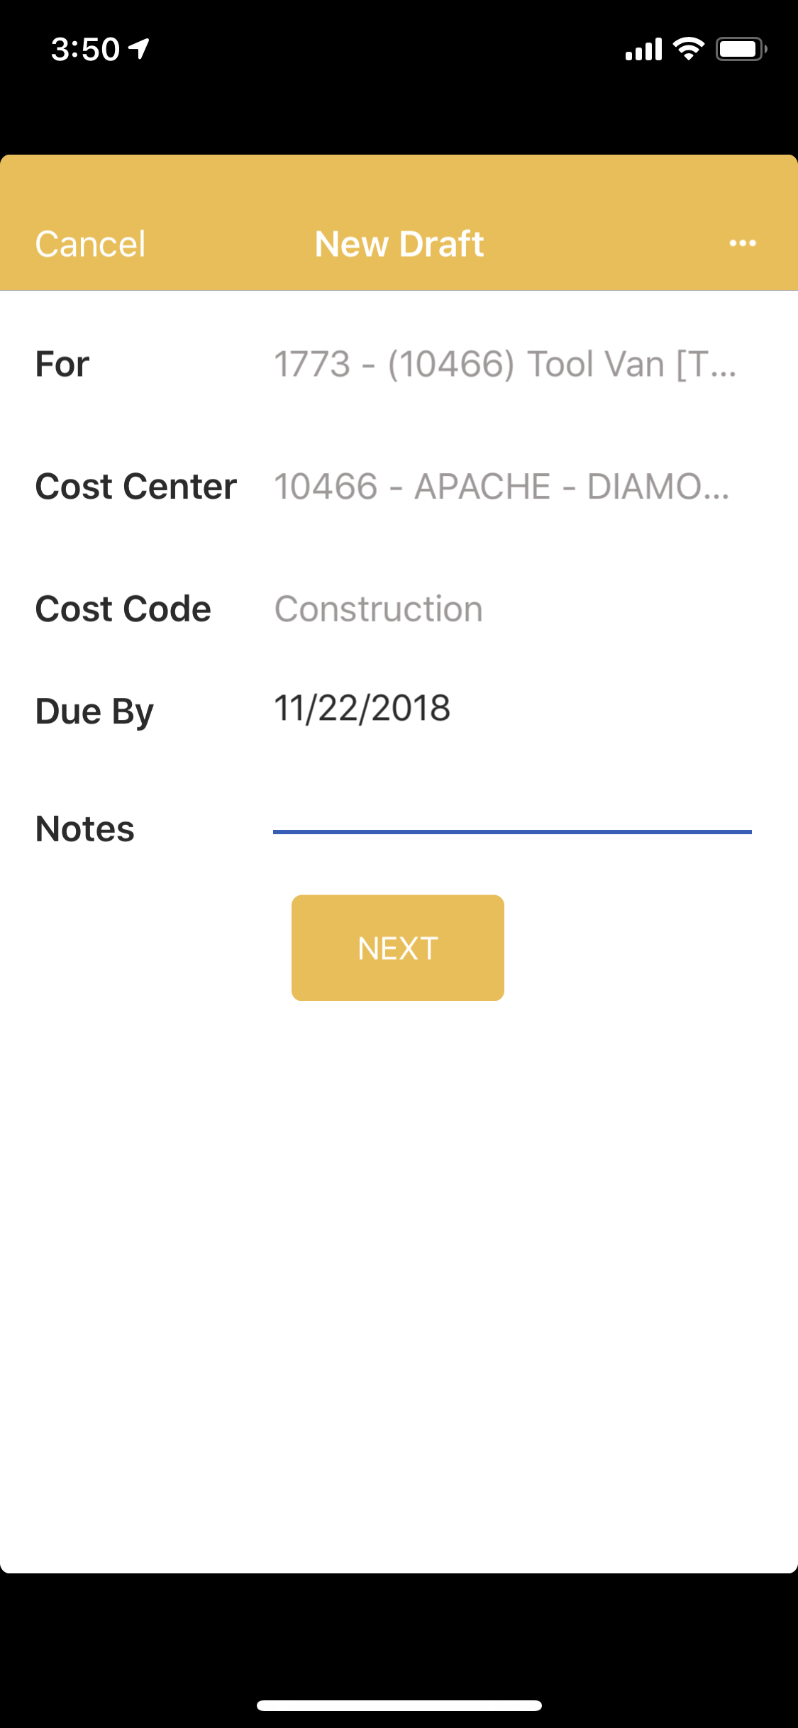
Specifying Request Details
After selecting the location, if a default Cost Center or Cost Code are present, this information will be used for job cost charges to the project for the use of the tools on the Request. In the example, the Cost Center of 10466 will import charges to this Spectrum job for the daily rate of all items assigned to the project from the Request.
The Cost Code is a simplified version of the Spectrum Phase Code. There are only 4 options for Cost Code; Construction, Electrical, Insulation, and Fabrication.
Specify the Due By, as the date tools on the Request should be delivered to the job site.
Enter any relevant notes as needed, such as the urgency of the need, or if the tools will be picked up at a Warehouse and do not need shipping.

Slide 11
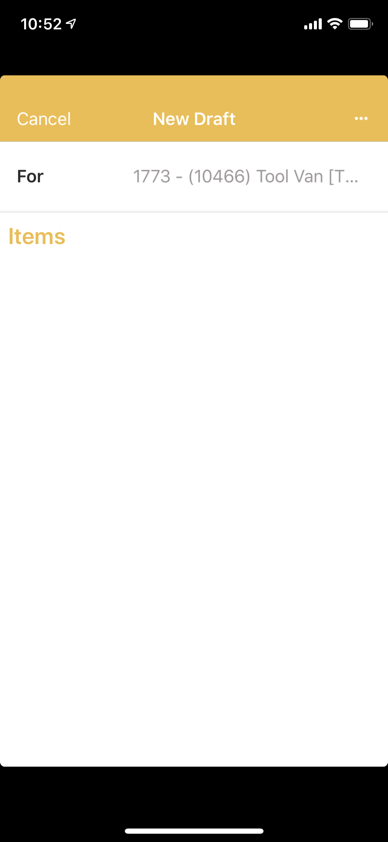
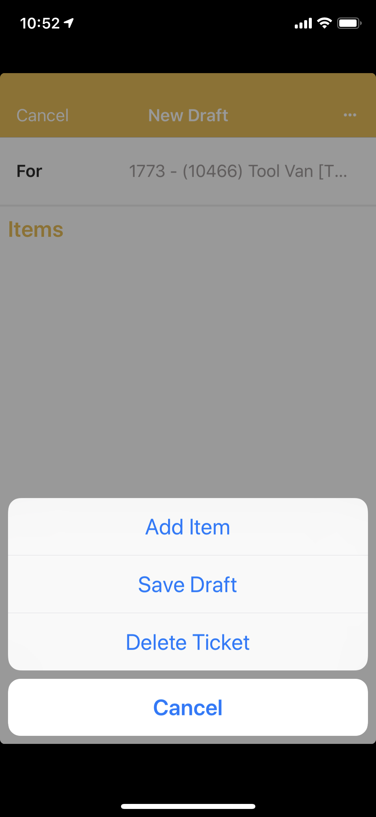
Drafting a Request
The location selected is now displayed next to “For”. When tools are added, they are listed below “Items”.
To add items to the Request, tap the request options button on the top right displayed with three dots …
Tap “Add Item” from the menu

Slide 12
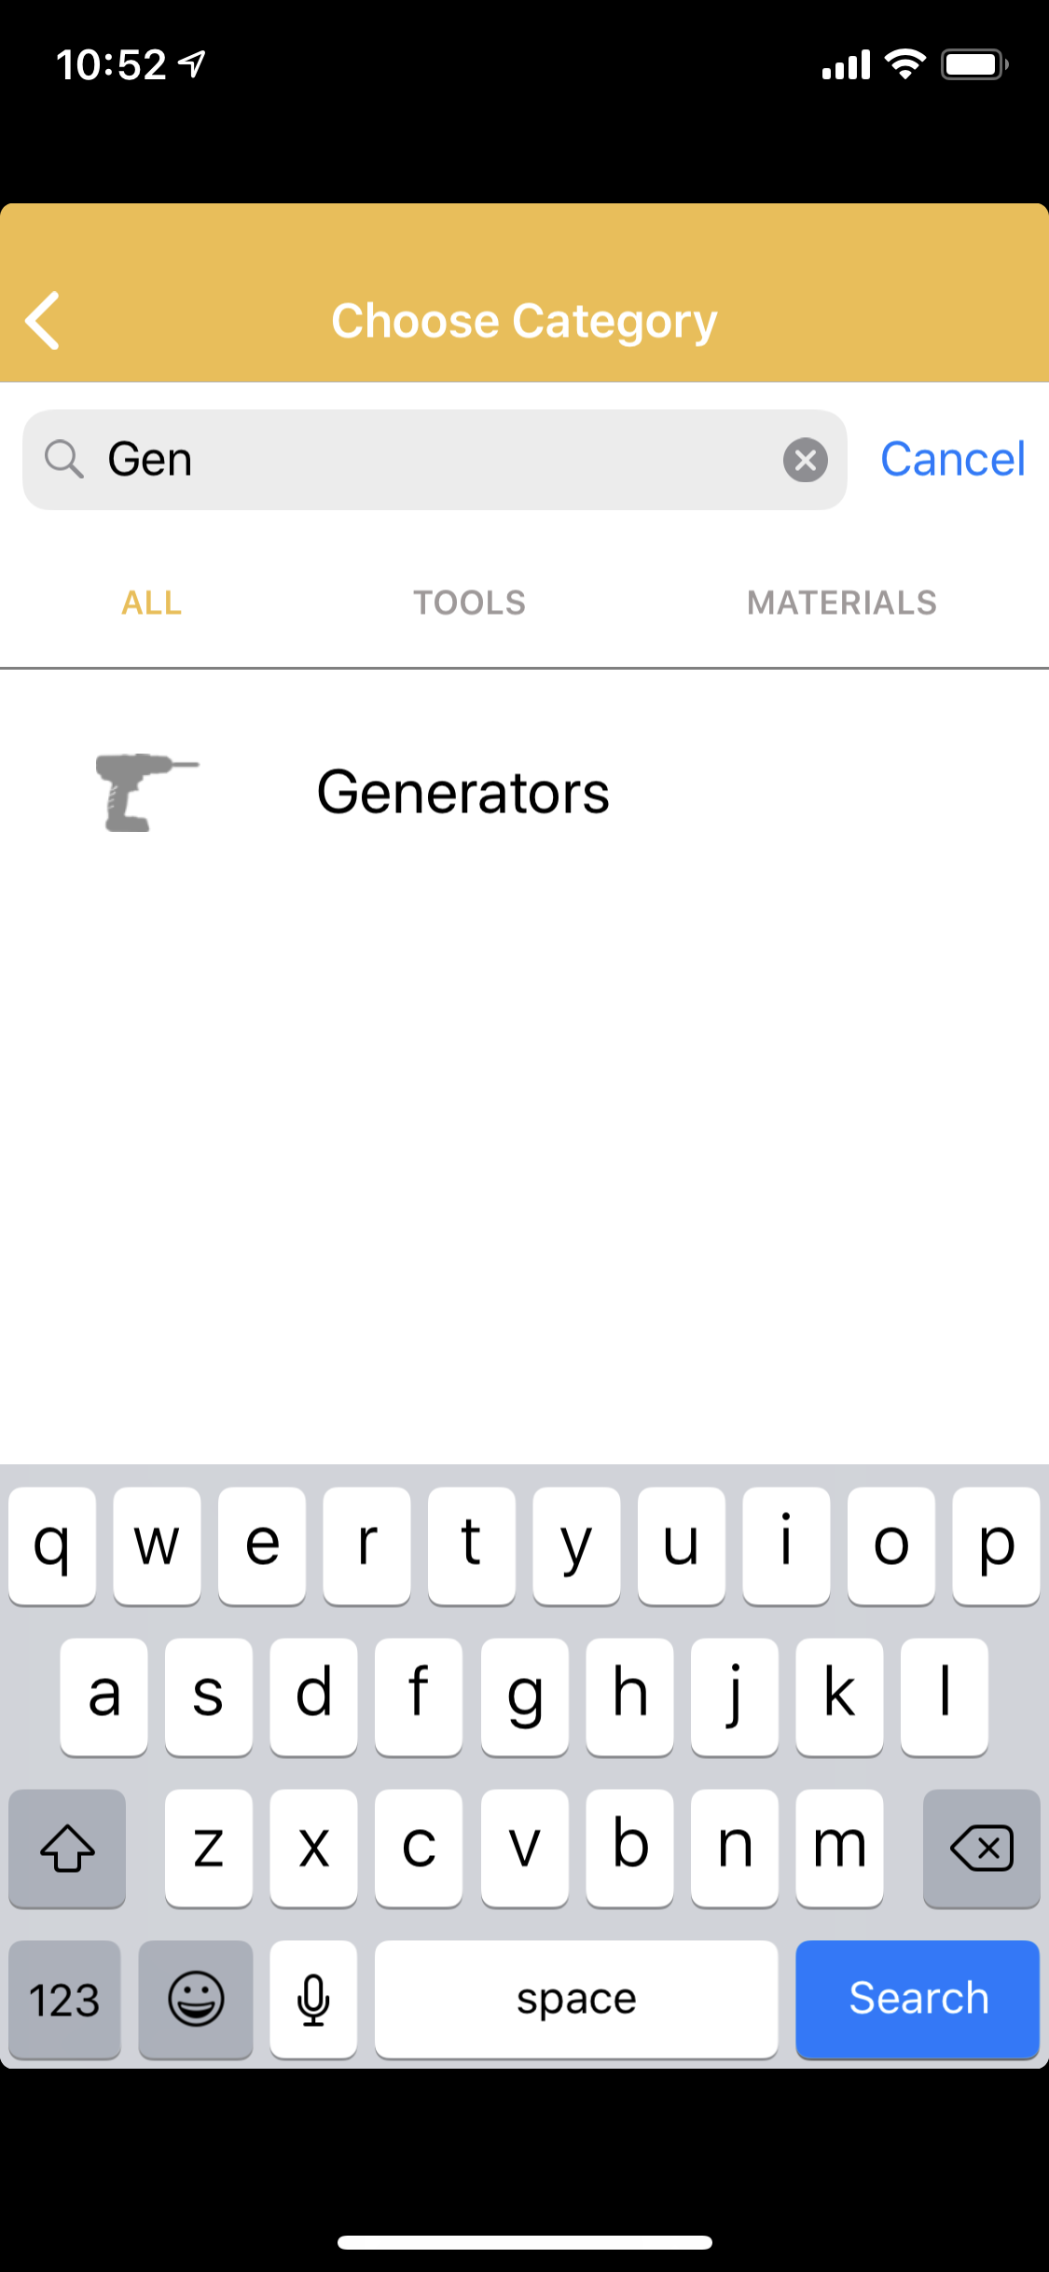
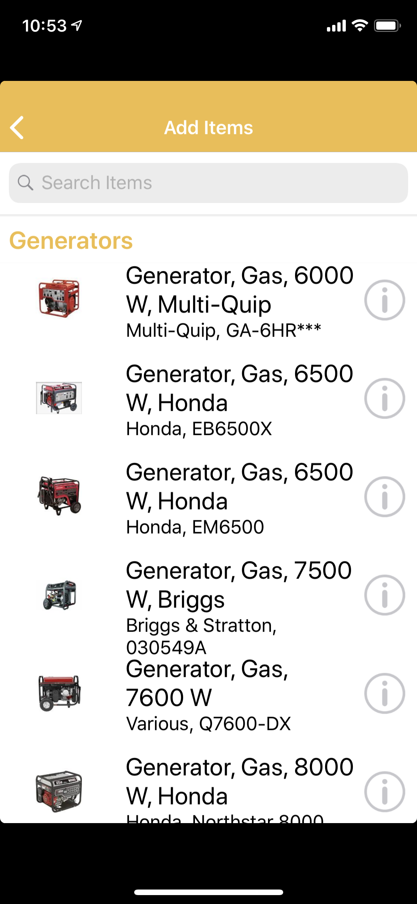
Searching and Adding Items
Using the search, start typing what you are looking for, the list will start filtering to Categories.
For example, typing “Gen” returns the tool category Generators.
Tap the category to view the list of Tool Models listed under the selected Category
Scroll through the list of Models under the selected Category or search from the items in the list.
For example, if “6000” were entered, only models for 6 Kw would be listed because “6000 W” is part of the description.
Tap the model needed to add to your Request.

Slide 13
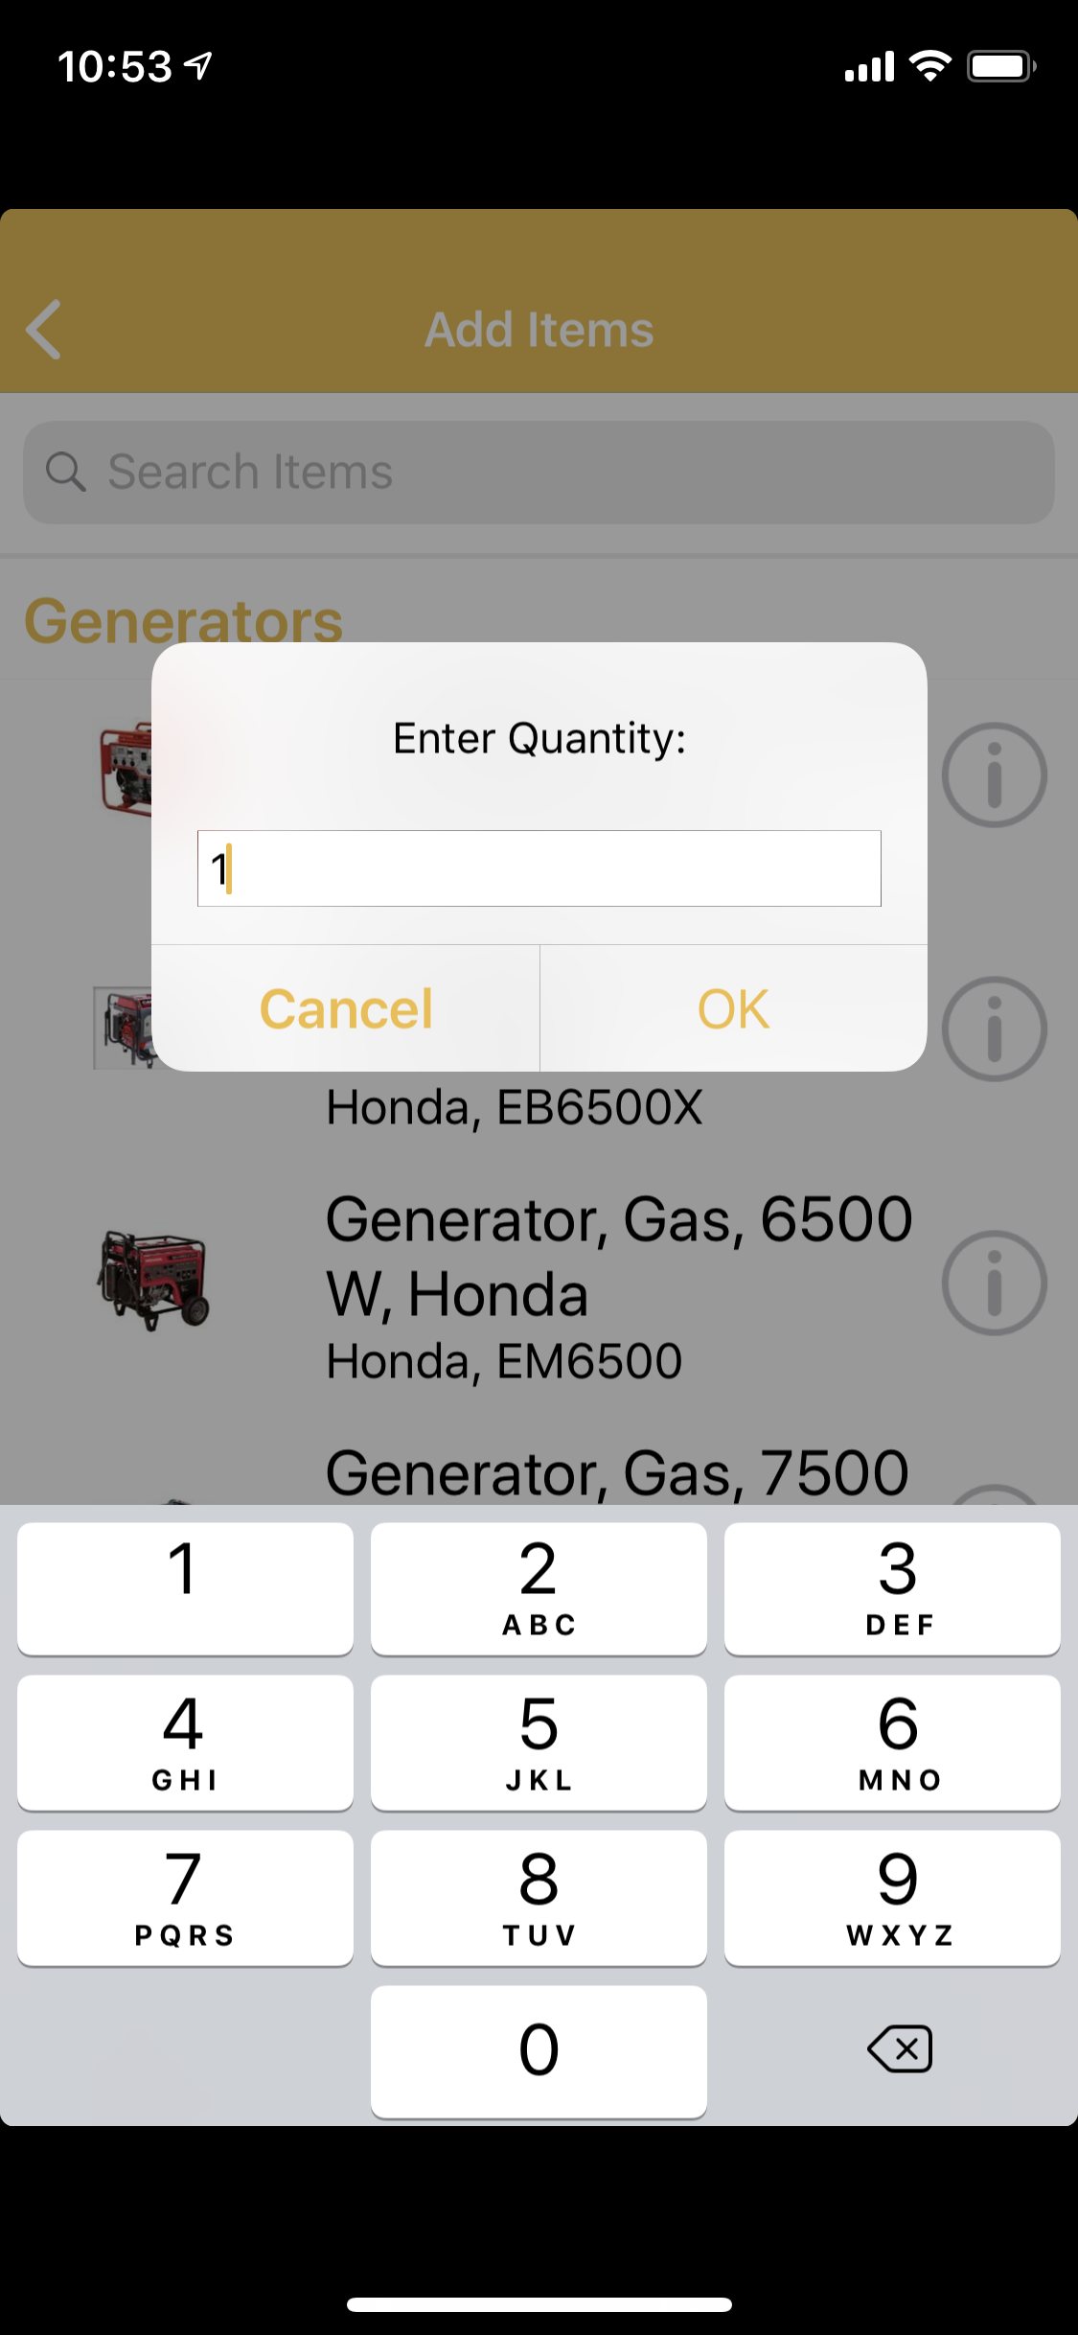
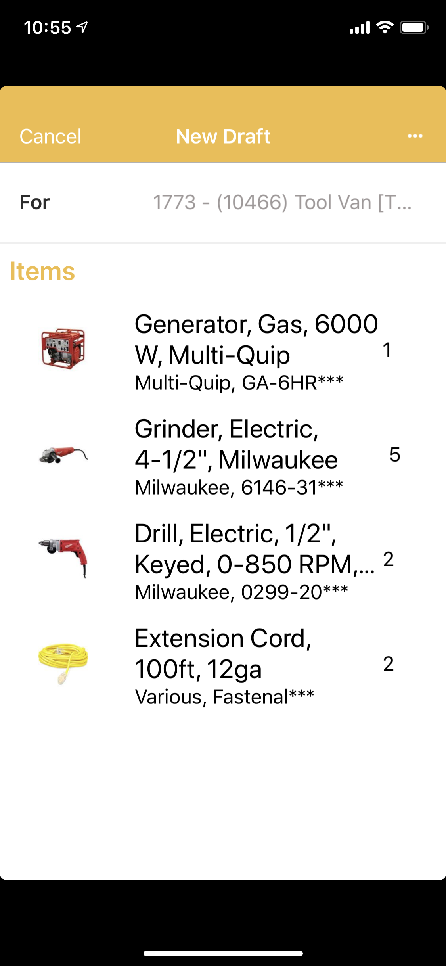
Searching and Adding Items
After selecting a Model Record to add to the Draft Request, specify the quantity required, then tap OK
To continue adding more items, tap the Request options menu button … and follow the previous steps searching the Category, selecting the Model Record, and specifying the quantity until all required tools are added to the Draft Request.

Slide 14
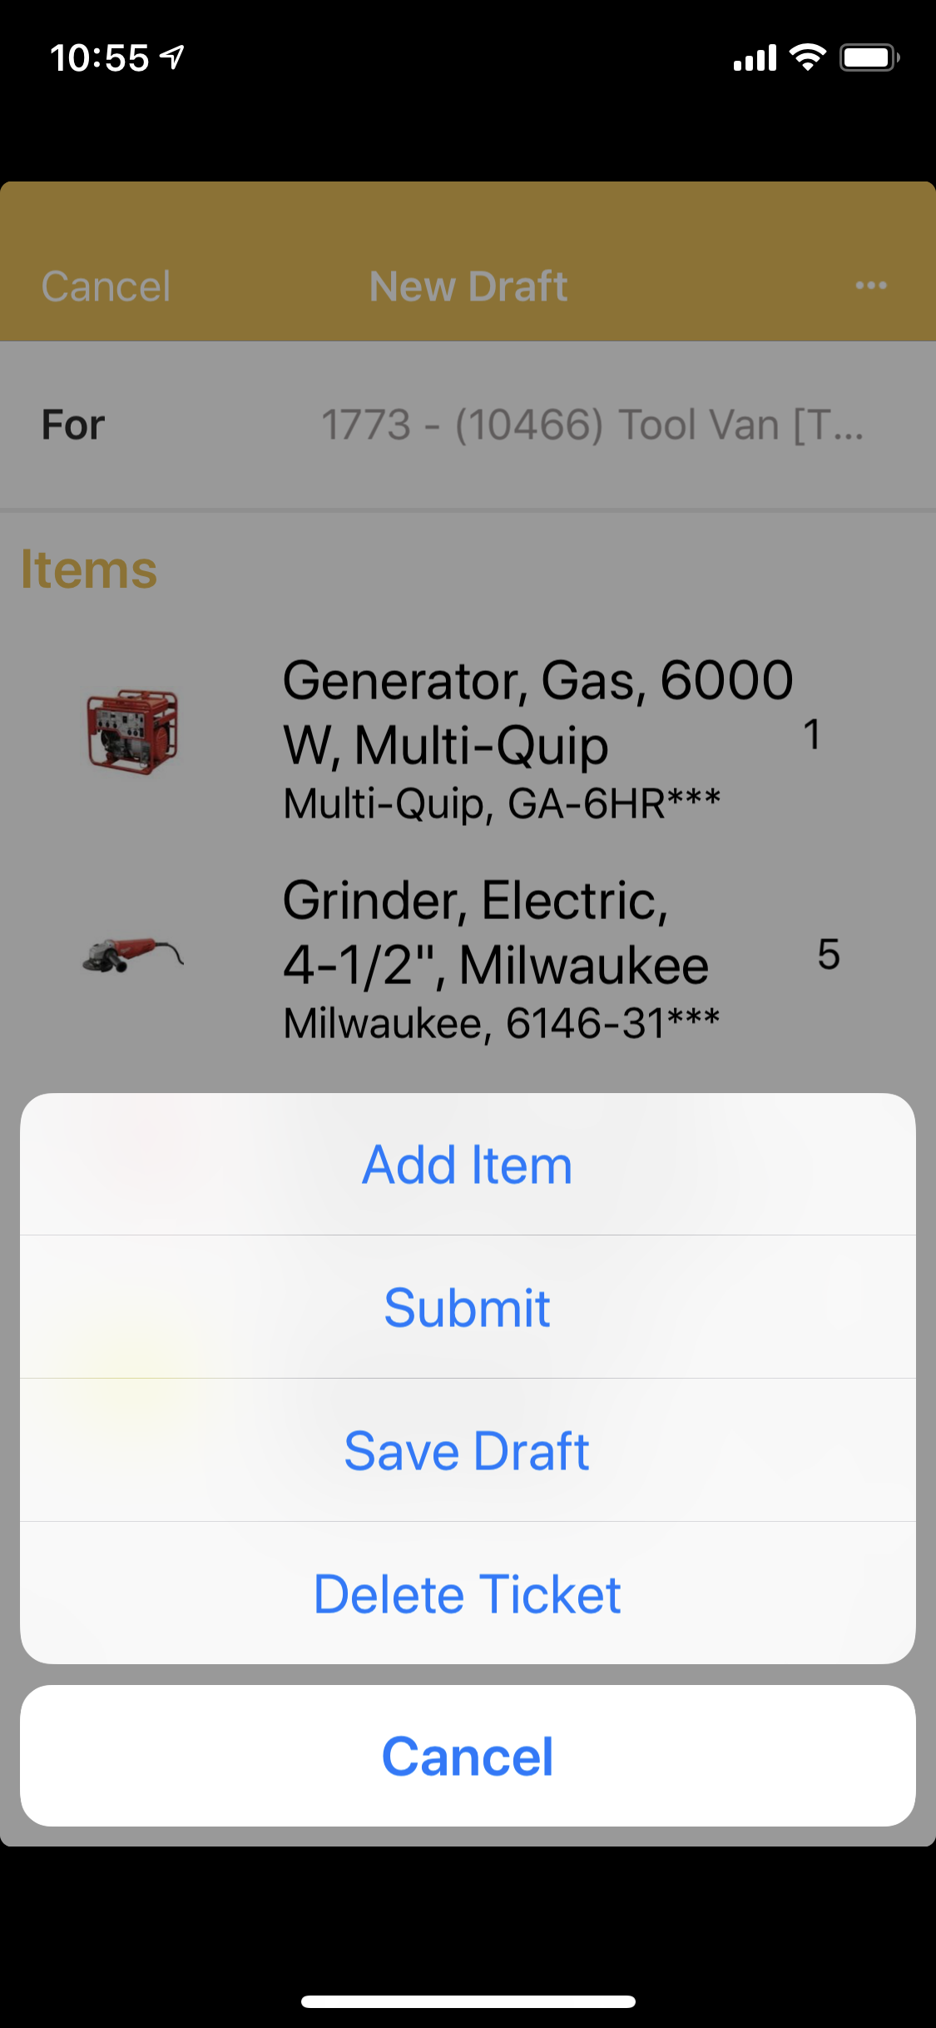
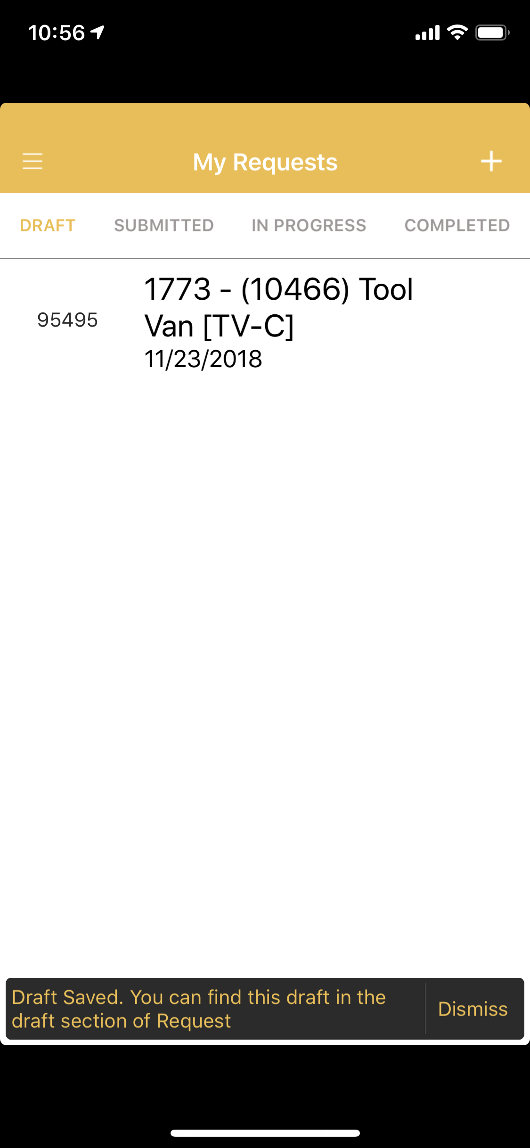
Saving Request as a Draft
To ensure all tools for your job are shipped together, save your Request as a draft before submitting. Verify with the project if anything else is needed.
After saving the Request as a draft, it will appear under “My Requests” under the Draft view.
Notice the number 95495 next to the Request is what the warehouse refers to as the Pick Ticket number.
Each Request is generated using it’s own unique number.

Slide 15
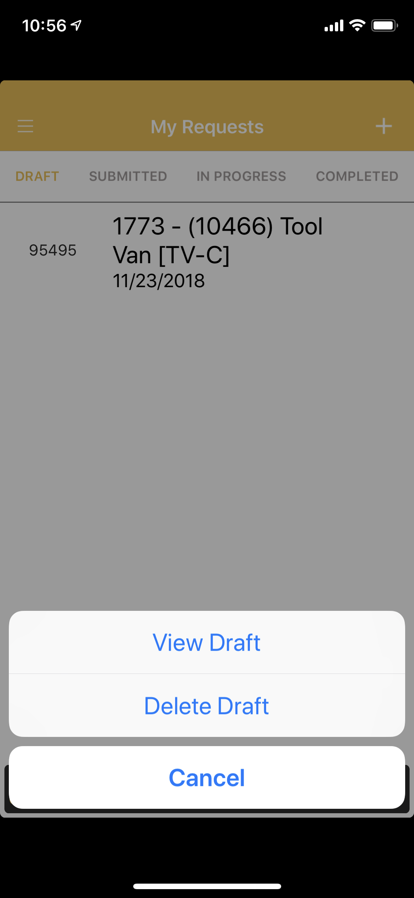
Reviewing your Draft Request
To review the items added to your draft request, or add additional tools, tap the request and then View Draft.
Alternatively, you can delete your draft if you decide you no longer need to request tools.
After tapping View Draft, if you decide you need to add more tools, just tap the request options …, and follow the previous steps of either adding Items, Saving Draft, or Submitting your request.
In the example, we added a quantity of two 3 Way 1ft Extension Cords before submitting.

Slide 16
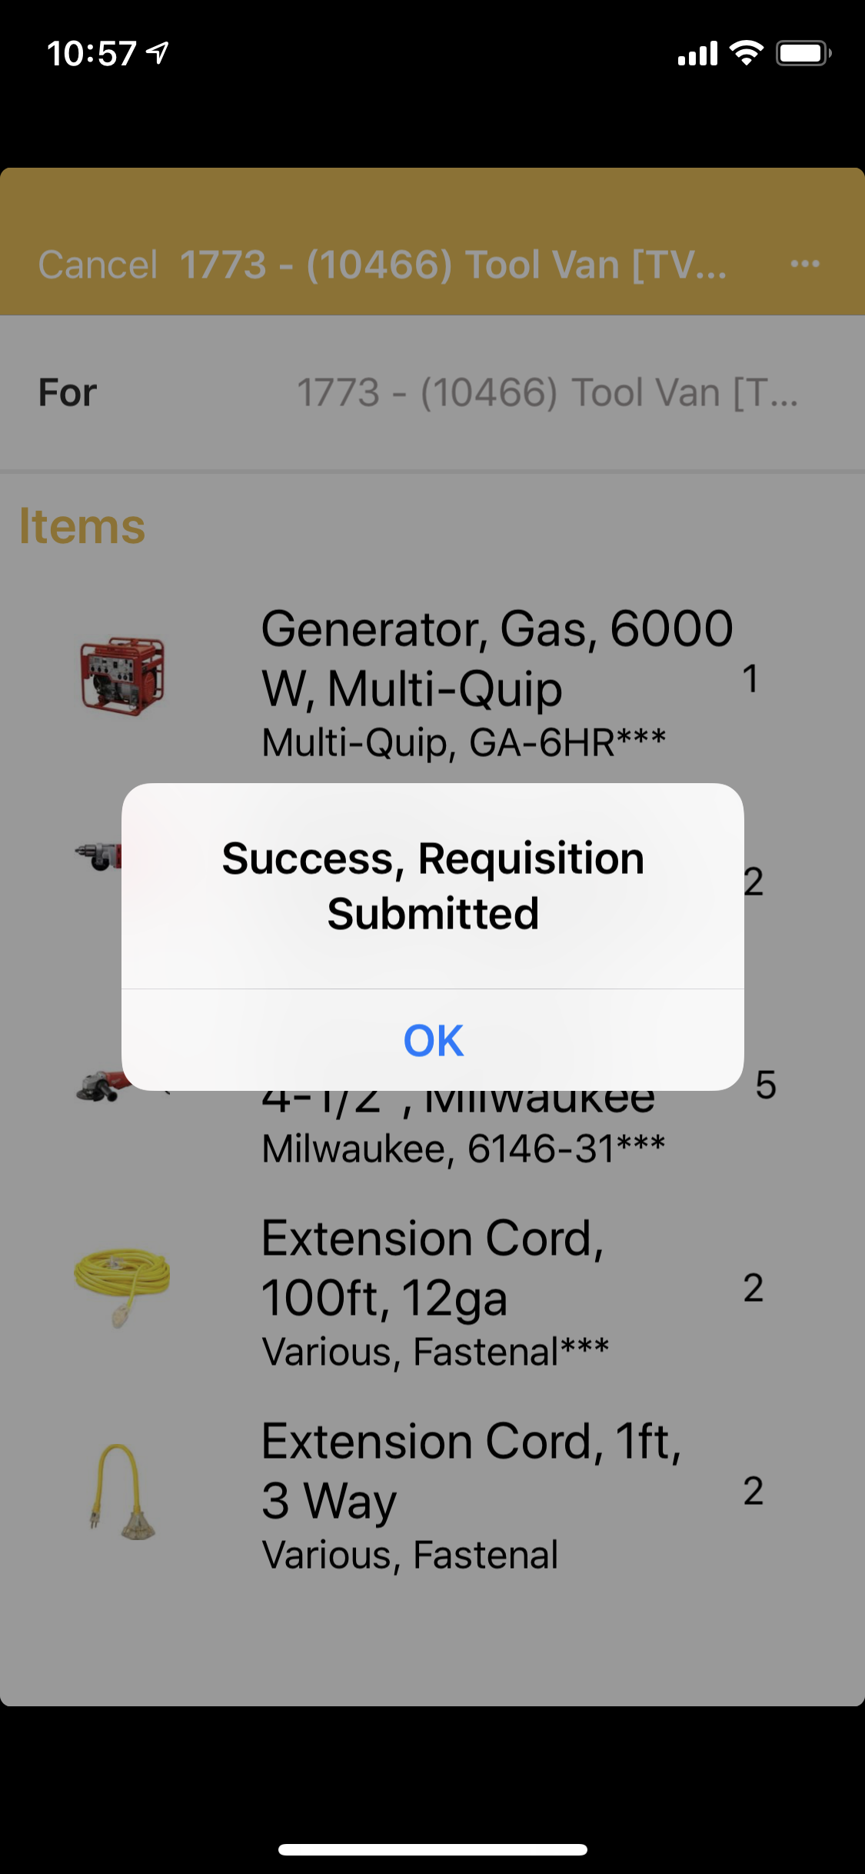
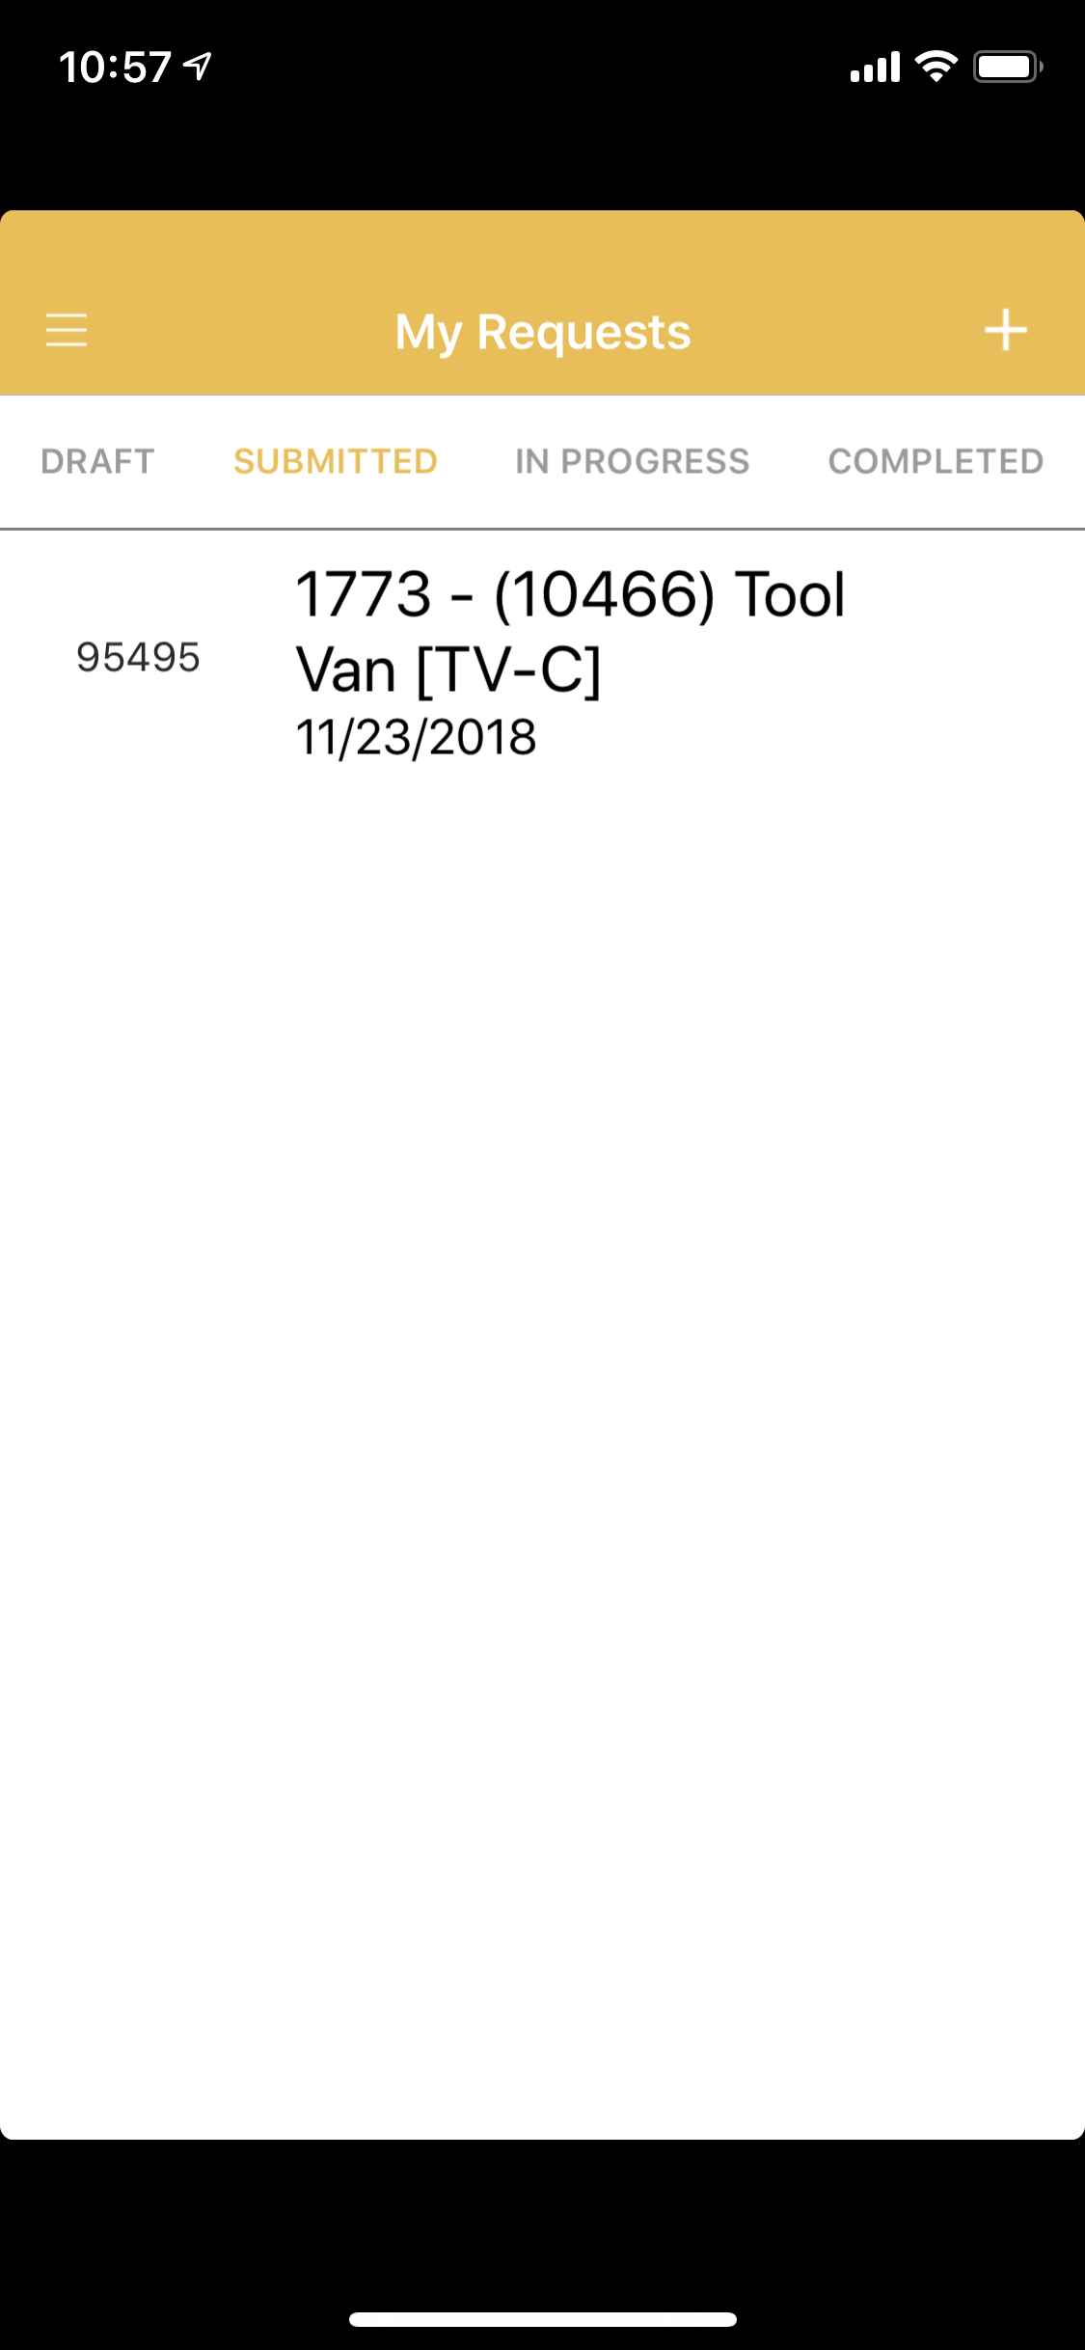
Submitting your Request
When you’ve completed adding tools to the request and selected Submit, you will receive an on screen confirmation “Success, Requisition Submitted”
Tap OK
The Request will now appear under the “Submitted” view in My Request.

Slide 17
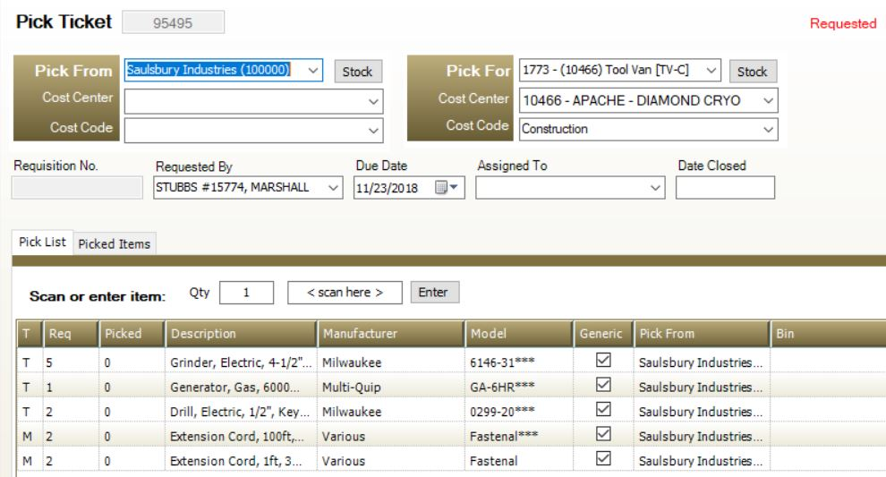
Processing your Request
When a Request is submitted, it will be visible to the Distribution Facility with a status of “Requested”. The Distribution Facility Supervisor will review each request, then assign it to an employee for fulfillment. After assignment, the request is now a “Pick Ticket” with the status of “Ready to Pick”. In the ToolWatch app, this action will move the request from “Submitted” to the “In Progress” view.

Slide 18
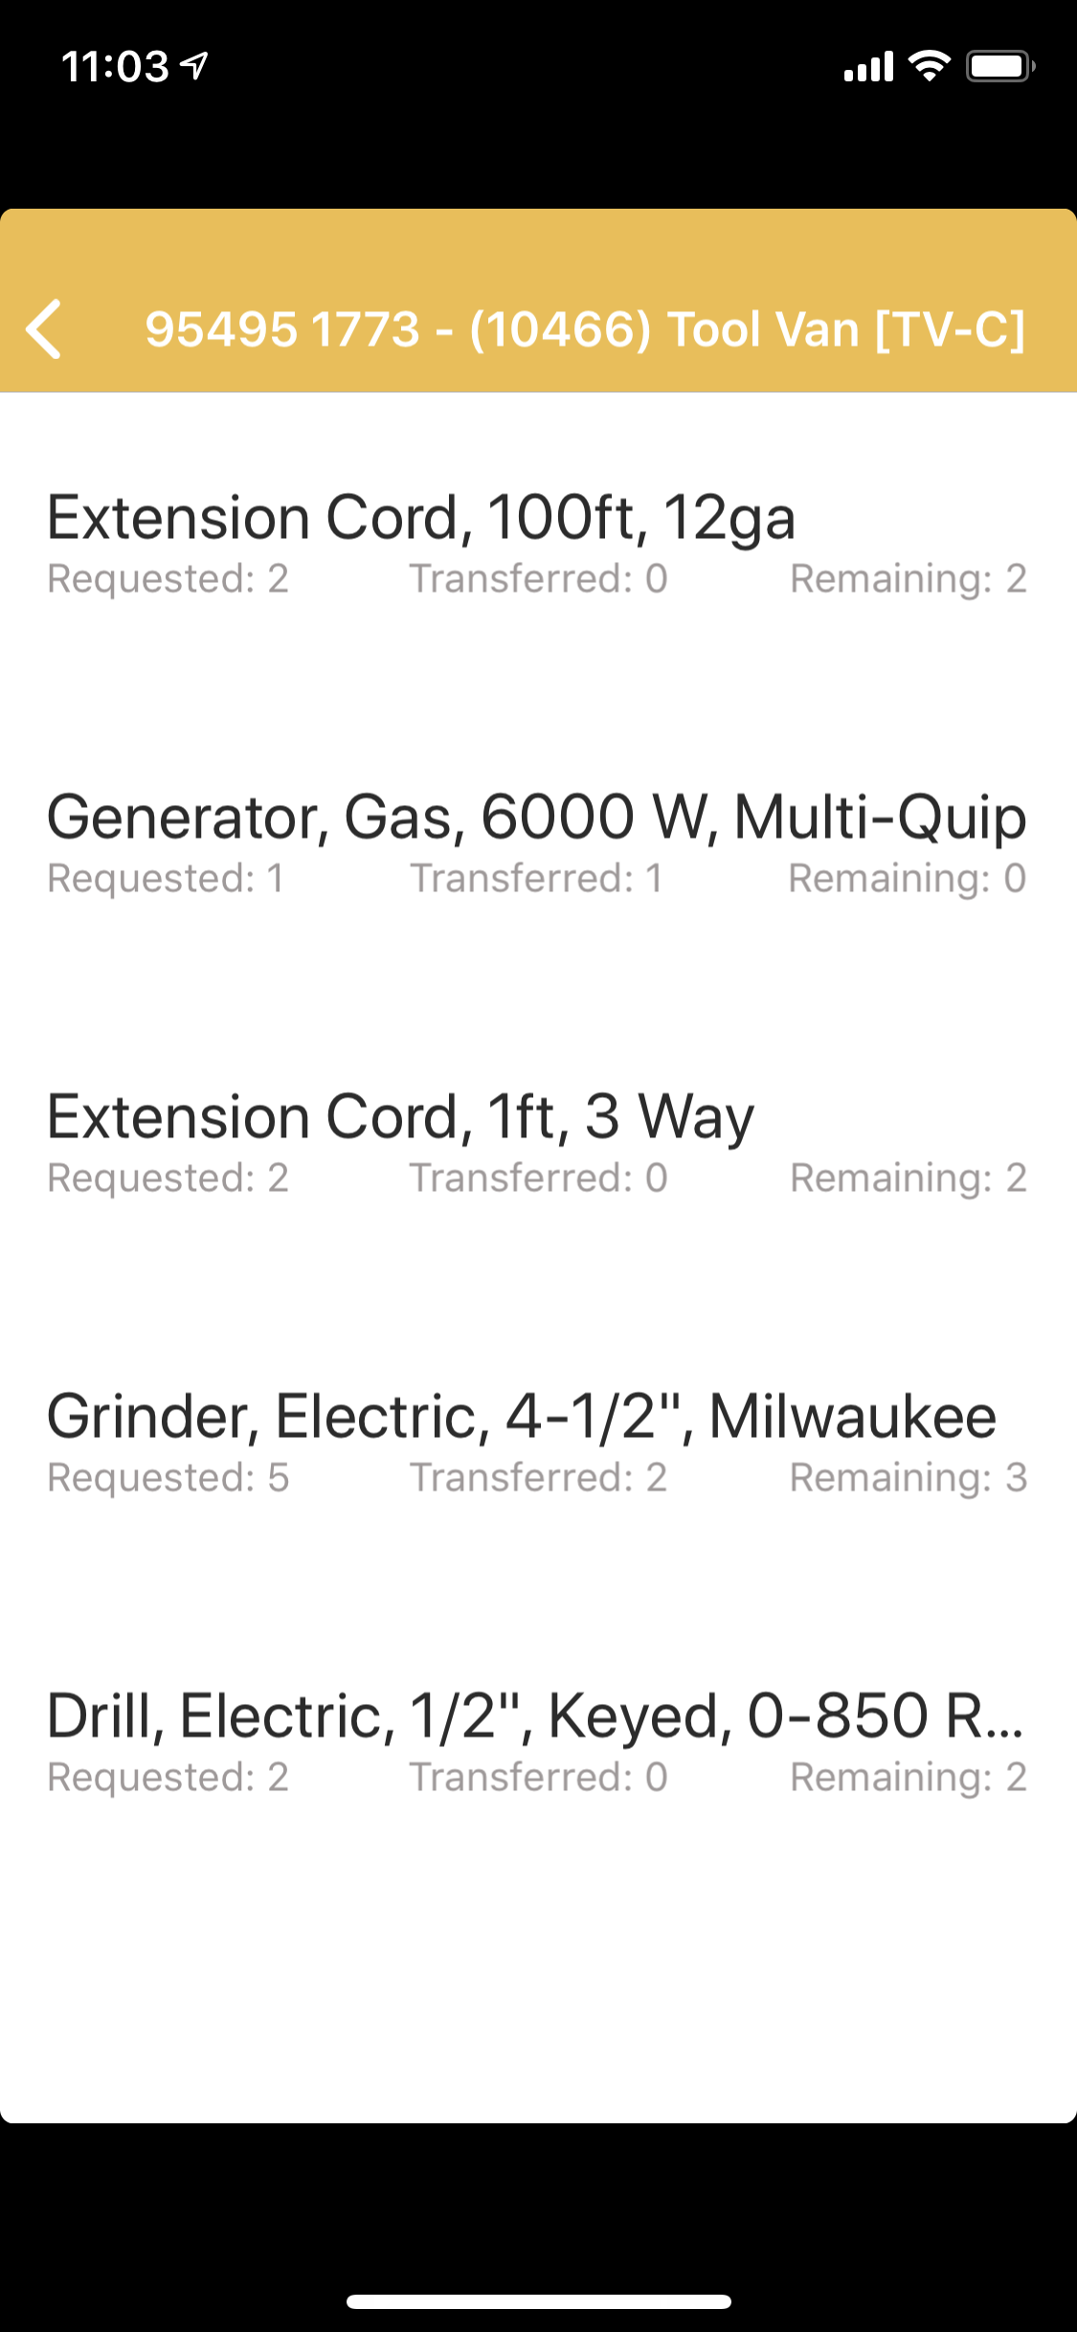
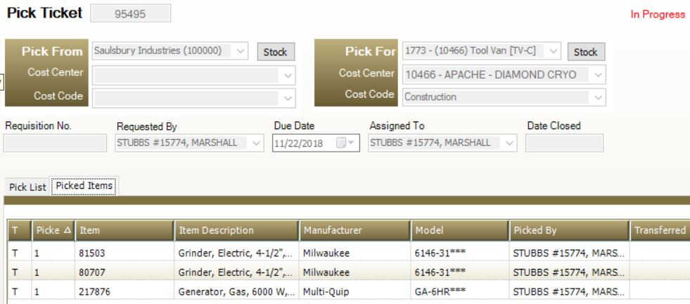
Processing your Request
When the status is In Progress, and items are being picked from stock, these updates are available for review in the ToolWatch App by viewing the request. In the example, notice grinders have a transferred quantity of 2 out of the requested 5, leaving 3 remaining.
The Pick Ticket will remain open at the warehouse until all requested items are transferred to the location specified on the request.

Slide 19
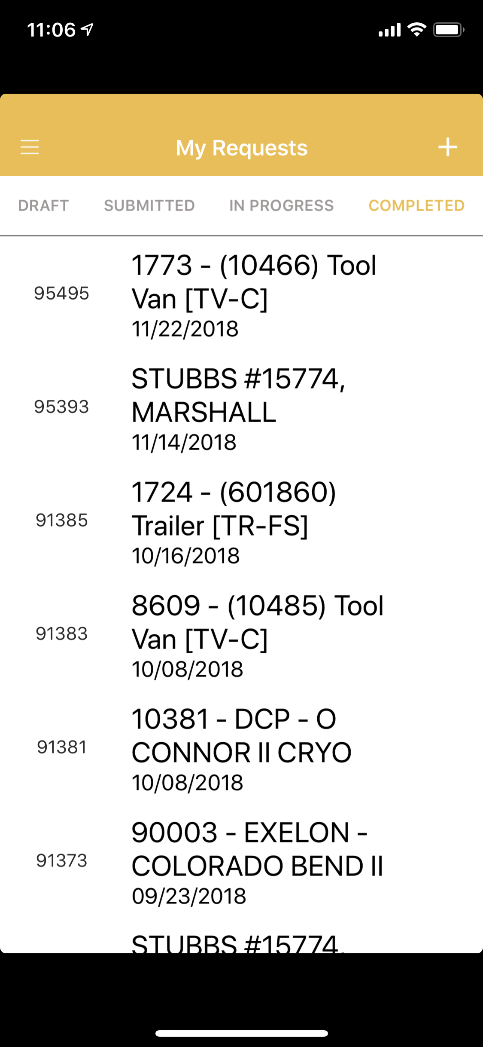
Completed Requests
All Completed Request submitted by the user signed In to the app are listed in My Requests under the “Completed” view.
When the Distribution Facility completes each request, email confirmation will be provided to the requester along with a copy of the Transfer Ticket, Photos, and BOL/Tracking information.

Slide 20
To request an account for ToolWatch, send an email to
ToolWatchAdmin@Saulsbury.com
Thank you
Questions or Comments?

